Slide 1
Historical Development of Engineering Management

Slide 2
Origins of Engineering Management: Ancient Civilization
Even the earliest civilizations required management skills wherever groups of people shared a common purpose: tribal activities, estates of the rich, military ventures, governments, or organized religions.
In ancient Mesopotamia, lying just north and west of Babylon, the temples developed an early concept of a “corporation”, or a group of temples under a common body of management. Flourishing as early as 3000 B.C., temple management operated under a dual control system: one high priest was responsible for ceremonial and religious activities, while an administrative high priest coordinated the secular activities of the organization. Records were kept on clay tablets, plans made, labor divided, and work supervised by a hierarchy of officials.

Slide 3


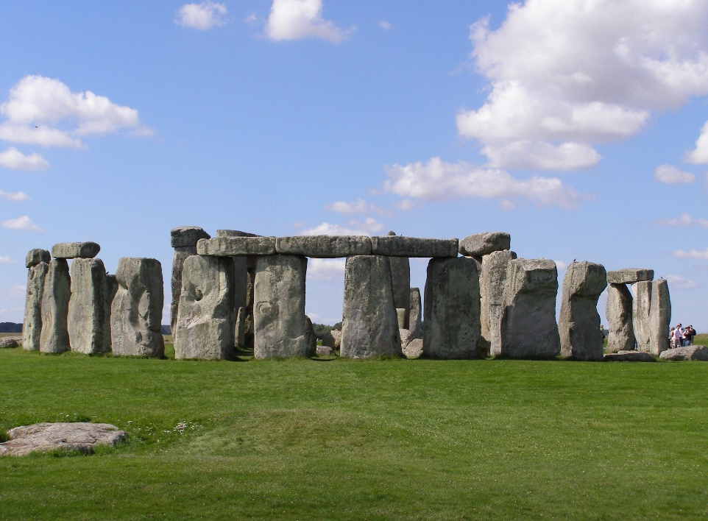


Slide 4
Examples: the Great Wall of China, Mayan temples in South America, Stonehenge in England, and the pyramids of Egypt.
The great pyramids of Cheops, built about 4500 years ago, covers 13 acres and contains 2,300,000 stone blocks weighing an average of 5000 pounds apiece. Estimates are that it took 100,000 men from 20 to 30 years to complete the pyramid – about the same effort in worker-years as it later took the United States to put a man on the moon. The only construction tools available were levers, rollers, and immense earthen ramps. Yet the difference in height of opposite corners of the base is only ½ inch!
Hammurabi (2123 – 2081 B.C.) of Babylon “issued a unique code of 282 laws which governed business dealings… and a host of other societal matters.” One law that should interest the civil engineer is the following:

Slide 5
If a builder builds a house for a man and does not make its construction firm, and the house which he has built collapses, and causes the death of the owner of the house, that builder shall be put to death.
Alexander the Great (336 – 323 B.C.) is generally credited with the first documented (European) use of the staff system. He developed an informal council whose members were each entrusted with a specific function (supply, provost marshal, and engineer)
Ancient records indicate that the Chinese were aware of certain principles bearing on organizing, planning, directing, and controlling.
In India, one Brahman Kautilya described in Arthasastra in 321 B.C. a wide range of topics on government, commerce, and customs. Because he analyzed objectively rather than morally the political practices that brought success to the past, his name “has become synonymous with sinister and unscrupulous management” in India.

Slide 6
Several industrial management practices of the Arsenal of Venice (1436 B.C.) that were ahead of their time: The Arsenal “had a threefold task: (1) the manufacture of galleys, arms, and equipment; (2) the storage of the equipment until needed; and (3) the assembly and refitting of the ships on reserve.
Systematic warehousing and inventory control of the hundreds of masts, spars, and rudders and thousands of benches, footbraces, and oars needed to make the assembly line work.
Well-developed personnel policies, including piecework pay for some work (making oars) and day wages for both menial labor and artisans (the latter with semiannual merit reviews and raises.
Standardization so that any ruder would meet any sternpost, and all ships were handled the same way
Meticulous accounting in two journals and one ledger, with annual auditing.
Cost control. As an example, one accountant discovered that lumber was stored casually in piles, and the process of searching through the piles to find a suitable log was costing three times as much as it did to buy the log in the first place; as a result of this early industrial engineering study an orderly lumberyard was established, which not only saved time and money but permitted accurate inventory of lumber on hand.

Slide 7
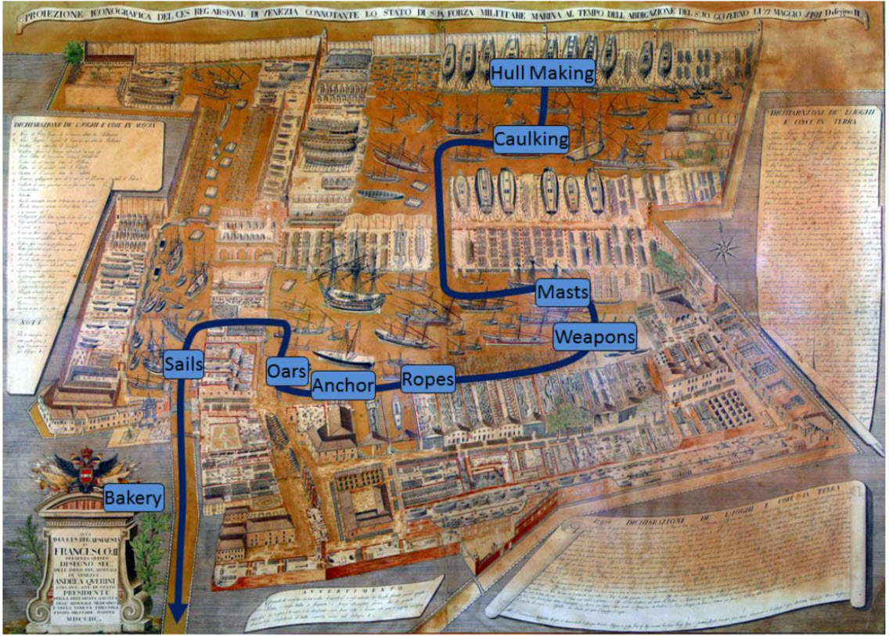

Slide 8
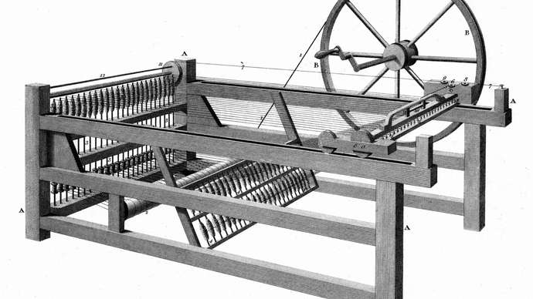
The Industrial Revolution
In the last third of the eighteenth century, a series of eight inventions (six British and two French) changed societies irretrievably.
The spinning jenny, invented by James Hargreaves in 1764, which could spin eight threads of yarn (later, 80) at once instead of one.

Slide 9
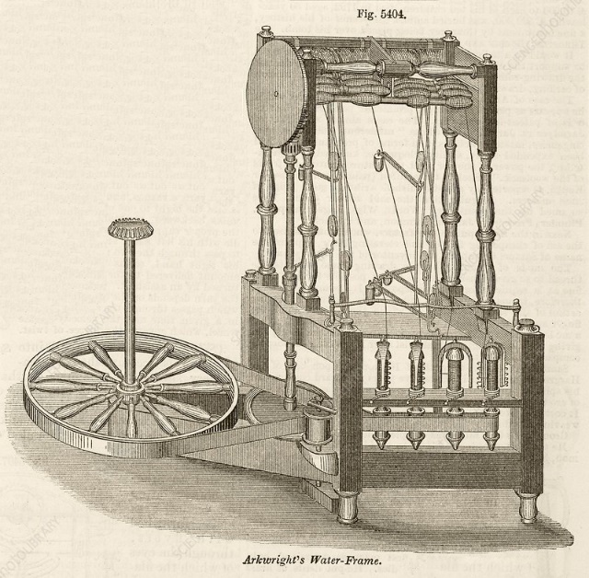
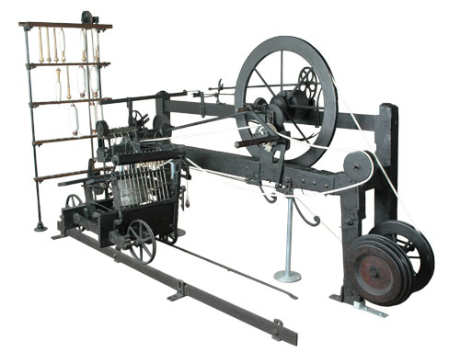
The water frame, a spinning machine driven by water power, patented by Richard Arkwright and incorporated by him in 1771 in the first of many successful mills.
The mule, a combination of the spinning jenny and water frame incented by Samuel Crompton in 1779, which enormously increased productivity and eliminated hand spinning.

Slide 10
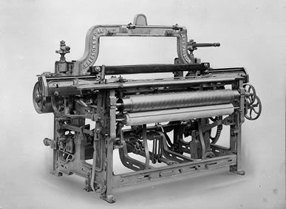
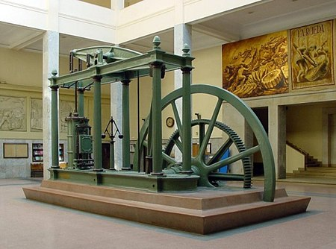
The power loom, a weaving machine patented in 1785 by Edmund Cartwright, which with time and improvements ended the ancient system of making cloth in the home.
Chlorine bleach, discovered in 1785 by the French chemist Claude Louis Berhollet (and bleaching powder in 1798 by Charles Tennant), which provided quick bleaching without the need for large open areas or constant sunlight.
The steam engine, patented by James Watt in 1769 and used in place of water power in factories beginning about 1785.

Slide 11
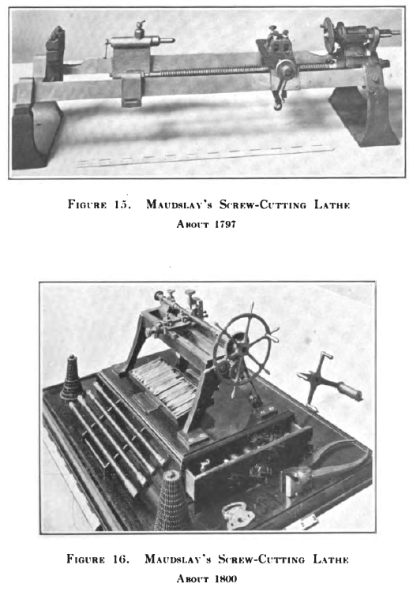
The screw-cutting lathe, developed in 1797 by Henry Maudslay, which made possible more durable metal (rather than wood) machines.
Interchangeable manufacture, commonly attributed to the American Eli Whitney in carrying out a 1798 contract for 10,000 muskets, but perhaps adopted by him as a result of a letter dated May 30, 1785, from Thomas Jefferson (while in France) to John Jay.

Slide 12
Problems of the Factory System
Problems of recruiting workers, training the largely illiterate workforce, and providing discipline and motivation to workers who had never developed the “habits of industry.”
“If a person can get sufficient [income] in four days to support himself for seven days, he will keep holiday for the other three.”
Explosive growth of the English mill towns led to filthy, overcrowded living conditions, widespread child labor, crime, and brutality.
Falling wages, rampant unemployment, and risking food prices led to a rash smashing of textile machinery, peaking in 1811 – 1812.

Slide 13
Supervisors often were illiterate workers who rose from the ranks and were paid little more than the workers they supervised, and there were no common body of knowledge about how to manage.
Upper management often consisted of the sons and relatives of the founders, a condition that persists today in many developing countries.

Slide 14
Industrial Development in America
An experienced textile machinery builder and mechanic Samuel Slated emigrated from England to America as a “farmer” and joined with three prosperous Rhode Island merchants to build the first technically advanced American textile mill in 1790; by 1810 the census listed 269 mills in operation.
Although growth of American industry was accelerated by the War of 1812 with England, most American firms before 1835 were small, family owned, and water powered.
Only 36 firms employed more than 250 workers: 31 textile firms, three iron, and two in nails and axes.

Slide 15
Canals (1790~1830): William Weston
Railroad (1830~1850): John Stevens
Telegraph line (1844~1860): Samuel Morse
Steel making (1870~1900): Andrew Carnegie

Slide 16
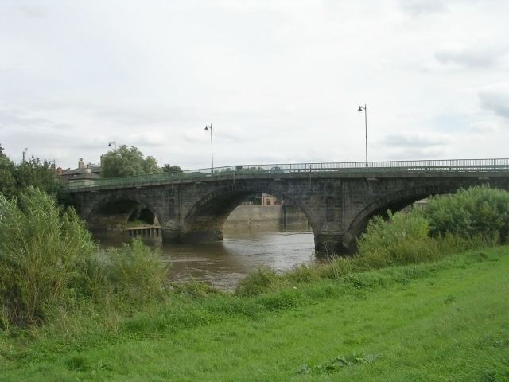
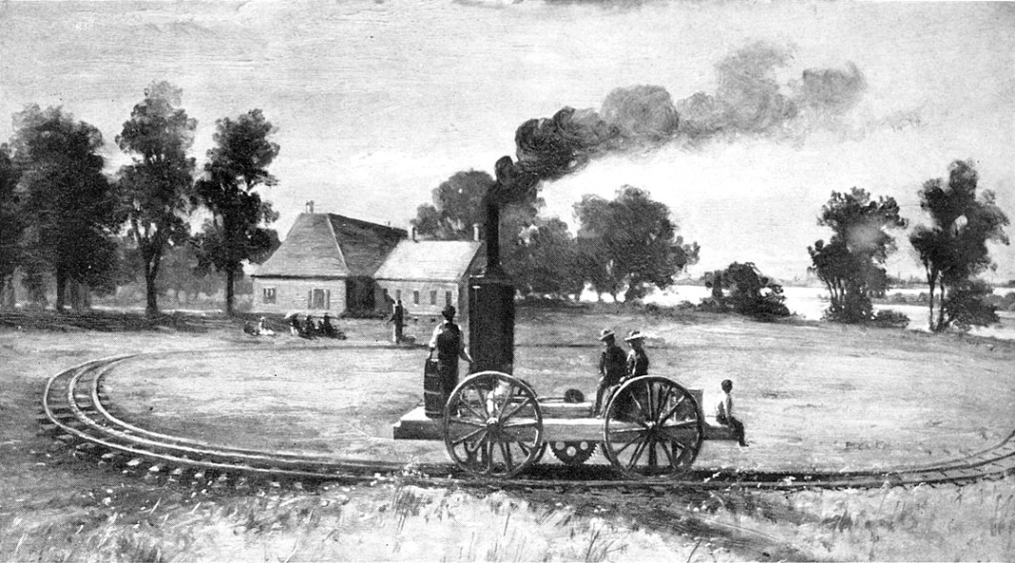
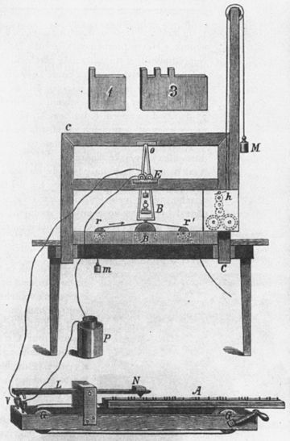
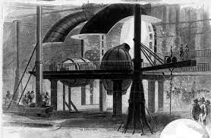

Slide 17
Development of Engineering Education
Most engineering skill through the eighteenth century was gained through apprenticeship to a practitioner.
When the American colonies revolted in 1776, they did not have the engineering resources needed to build (or destroy) fortifications, roads, and bridges, and they had to rely on French, Prussian, and Polish assistance.
Established the United States Military Academy at West Point, New York, in 1802 to provide training in, among other things, practical science.
Graduates did not acquit themselves as well as hoped in the War of 1812 with England.

Slide 18
Sylvanis Thyer, assistant professor of mathematics and Lt. Colonel Willian McRee were sent to Europe in 1815 to examine curricula at Ecole Polytechnic, the most famous scientific military school in the world.
After their return in 1817, Thayer collected the best teachers in physics, engineering, and mathematics available and set up a four-year civil engineering program.
Many of the great canals, railroads, and bridges constructed during the nineteenth century were built by West Point graduates.
The faculty, recruited by Thayer, wrote textbooks that dominated the subjects of mathematics, chemistry, and engineering during the 1800s.

Slide 19
Engineering Schools soon began to emerge:
Norwich (Connecticut) University (1819)
Rensselear (New York) Polytechnic Institute (1823)
Union College (1845)
Harvard, Yale, Michigan (1847)
The event that had the greatest influence on engineering education was passage of the Morrill Land Grant Act in 1862.
This act gave federal land (ultimately [totaling] 13,000,000 acres, an area 46% greater than Taiwan) to each state to support ‘at least one college where the leading object shall be… scientific and classical studies… agriculture and mechanic arts.”
This made education in the “mechanic arts” (which became engineering) available and affordable throughout the country.
1893 – More than one hundred engineering schools

Slide 20
Management Philosophies
Goal
Obtain optimal organizational performance, with the overall business environment guiding the selection of a particular style of management.
Some theories have been fads that have not influenced a company’s performance in the long term, and others enhance quality and productivity.
Each theory has had its merits and drawbacks.
These philosophies may be grouped in general categories as follows:
Scientific, Administrative, and Behavioral

Slide 21
Scientific Management
The application of scientific methods to analyze work and to determine how to complete production tasks efficiently.
The use of the scientific method to define the “one best way” for a job to be done.
Scientific management was developed to solve two major problems:
how to increase the output of the average worker, and
how to improve the efficiency of management

Slide 22
Charles Babbage (1792 – 1871)
The “grandfather of scientific management”
Invented first practical mechanical calculator – “difference engine” in 1822.
Described his ideas on division of labor, “method of observing manufactures”, and methods of optimizing factory size and location, and a profit-sharing scheme in a very successful book On the Economy of Machinery and Manufactures, in 1832.
Henry Towne and the American Society of Mechanical Engineers (ASME)
Towne cited the need for a medium for the interchange of management experience
Consideration of matters of shop management became parts of ASME meetings, and the ASME Management Division (Towne’s 1886 paper).

Slide 23
Frederick W. Taylor (1856 – 1915)
The “father of scientific management”
Conducted a series of experiments in which work was broken down into its “elements” and the elements timed to establish what represented a “fair day’s work”
Encouraged by Henry Towne’s paper, continued studies of work methods and shop management
“A piece rate system” - a paper presented to the ASME in 1895 - involved breaking a job into elementary motions, discarding unnecessary motions, examining the remaining motions (usually through stopwatch studies) to find the most efficient method and sequence of elements, and teaching the resulting methods to workers.

Slide 24
The worker would be paid according to the quantity of work produced.
“Differential piecework” method: one piece rate if the worker produced the standard number of pieces, and a higher rate for all work if the worker produced more.
Bethlehem Iron Company (1898).
By developing a method that involved frequent rest periods number of tons loaded by a worker in a day increased from 12.5 to 47.5.
Workers’ earnings increased from $1.85 a day, while management’s cost per ton handled was reduced by 55 percent or more.

Slide 25
In his 1911 book Principles of Scientific Management, Taylor summarized his methods as a combination of four principles:
Develop a science for each element of a man’s work, which replaces the old rule-of-thumb method.
Scientifically select, then train, teach, and develop the workmen, whereas in the past he chose his own work and trained himself as best he could.

Slide 26
Heartily cooperate with the men so as to insure all of the work being done in accordance with the principles of the science which has been developed.
There is an almost equal division of the work and the responsibility between the management and the workmen. The management take over all work for which they are better fitted than the workmen [defining how work is to be done], while in the past almost all of the work and the greater part of the responsibility were thrown upon the men.

Slide 27
The Gilbreths
Frank B. Gilbreth (1868 – 1924) found that bricklayers used three sets of motions: one when working deliberately but slowly, another when working rapidly, and a third when trying to teach their helpers! Gilbreth resolved to find the “one best way.”
By 1895 Gilbreth has his own construction firm based on “speed work.”
He analyzed each job to eliminate unnecessary motions, devising a system of classifying hand motions into 17 basic divisions such as “search,” “select,” and “hold.”

Slide 28
Lillian Moller Gilbreth (1878 – 1972). “The Psychology of Management”, one of the earliest contributions to understanding the human factor in industry.
The first woman admitted to the Society of Industrial Engineers and the ASME, the first woman professor of management at an engineering school (Purdue University and later the Newark College of Engineering), and only woman to date to be awarded the Gilbreth Medal, the Gantt Gold Medal, or the CIOS Gold Medal.
The “first lady of management.”

Slide 29
Growth and Implications of Scientific Management
Henry Laurence Gantt (1861 – 1919). Incentive system that gave workers a bonus for completing their jobs less time than allowed standards. Also developed Gantt chart that graphed some function against time.
Morris L. Cooke (1872 – 1960). Labor was as important for production as management.
Universities increasingly decided management was, after all, worthy study. Stevens (1902), Yale (1911), and MIT (1913).

Slide 30
Criticism of Scientific Management
Workers Viewpoint
Unemployment - Workers feel that management reduces employment opportunities from them through replacement of men by machines and by increasing human productivity less workers are needed to do work leading to chucking out from their jobs.
Exploitation - Workers feel they are exploited as they are not given due share in increasing profits which is due to their increased productivity. Wages do not rise in proportion as rise in production. Wage payment creates uncertainty & insecurity (beyond a standard output, there is no increase in wage rate).

Slide 31
Monotony - Due to excessive specialization the workers are not able to take initiative on their own. Their status is reduced to being mere cogs in wheel. Jobs become dull. Workers loose interest in jobs and derive little pleasure from work.
Weakening of Trade Union - To everything is fixed & predetermined by management. So it leaves no room for trade unions to bargain as everything is standardized, standard output, standard working conditions, standard time etc. This further weakens trade unions, creates a rift between efficient & in efficient workers according to their wages.
Over speeding - the scientific management lays standard output, time so they have to rush up and finish the work in time. These have adverse effect on health of workers. The workers speed up to that standard output, so scientific management drives the workers to rush towards output and finish work in standard time.

Slide 32
Employer’s Viewpoint
Expensive - Scientific management is a costly system and a huge investment is required in establishment of planning dept., standardization, work study, training of workers. It may be beyond reach of small firms. Heavy food investment leads to increase in overhead costs.
Time Consuming - Scientific management requires mental revision and complete reorganizing of organization. A lot of time is required for work, study, standardization & specialization. During this overhauling of organization, the work suffers.
Deterioration of Quality

Slide 33
Administrative Management
Henri Fayol (1841 – 1925)
Concept of universal nature of management and a broad framework for administrative management (which has significant influence on the modern day management).
Fayol described the practice of management as distinct from accounting, finance, production, distribution, and other typical business functions.
Five functions of Administrative Management:
Planning/Forecasting
Organizing
Commanding
Coordinating
Controlling

Slide 34
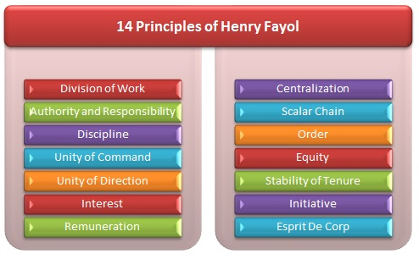

Slide 35
Division of Work – When employees are specialized, output can increase because they become increasingly skilled and efficient.
Authority – Managers must have the authority to give orders, but they must also keep in mind that with authority comes responsibility.
Discipline – Discipline must be upheld in organizations, but methods for doing so can vary.
Unity of Command – Employees should have only one direct supervisor.
Unity of Direction – Teams with the same objective should be working under the direction of one manager, using one plan.
Subordination of Individual Interests to the General Interest – The interests of one employee should not be allowed to become more important than those of the group. This includes managers.
Remuneration – Employee satisfaction depends on fair remuneration for everyone.

Slide 36
Centralization – This principle refers to how close employees are to the decision-making process. It is important to aim for an appropriate balance.
Scalar Chain – Employees should be aware of where they stand in the organization's hierarchy, or chain of command.
Order – The workplace facilities must be clean, tidy and safe for employees. Everything should have its place.
Equity – Managers should be fair to staff at all times, both maintaining discipline as necessary and acting with kindness where appropriate.
Stability of Tenure of Personnel – Managers should strive to minimize employee turnover. Personnel planning should be a priority.
Initiative – Employees should be given the necessary level of freedom to create and carry out plans.
Esprit de Corps – Organizations should strive to promote team spirit and unity.

Slide 37
Max Weber (1864 – 1920)
Weber developed a model for a rational and efficient large organization, which he termed as bureaucracy.
Bureaucracy – “an ideal form of organization whose activities and objectives are rationally thought out and whose division of labor are explicitly spelled out.”
- characterized by division of labor, a clearly defined hierarchy, detailed rules and regulations, and impersonal relationships.

Slide 38
Weber’s Ideal Bureaucracy (or Theory of Bureaucracy)
Division of Labor. Jobs are broken down into simple, routine, and well-defined tasks.
Authority Hierarchy. Offices or positions are organized in a hierarchy, each lower one being controlled and supervised by a higher one.
Formal Selection. All organizational members are to be selected on the basis of technical qualifications demonstrated by training, education, or formal examination.

Slide 39
Formal Rules and Regulations. To ensure uniformity and to regulate the actions of employees, managers must depend heavily on formal organizational rules.
Impersonality. Rules and controls are applied uniformly, avoiding involvement with personalities and personal preferences of employees.
Career Orientation. Managers are professional officials rather than owners of the units they manage. They work for fixed salaries and pursue their careers within the organization.

Slide 40
Behavioral Management
The behavioral management theory is often called the human relations movement because it addresses the human dimension of work.
Behavioral theorists believed that a better understanding of human behavior at work, such as motivation, conflict, expectations, and group dynamics, improved productivity.
The theorists who contributed to this school viewed employees as individuals, resources, and assets to be developed and worked with — not as machines, as in the past.

Slide 41
Hawthorne Studies
The research team, headed by Elton Mayo (1880 – 1949), was formed to study the effects of the physical environment, such as changes in the level of lighting in the working area, upon the productivity of workers.
The Hawthorne experiments consisted of two studies conducted at the Hawthorne Works of the Western Electric Company in Chicago from 1924 to 1932.
The first study was conducted by a group of engineers seeking to determine the relationship of lighting levels to worker productivity.
Workers’ productivity increased as the lighting levels decreased — that is, until the employees were unable to see what they were doing, after which performance naturally declined.

Slide 42
Second group of experiments began in which the researchers supervised a group of five women in a bank wiring room.
They gave the women special privileges, such as the right to leave their workstations without permission, take rest periods, enjoy free lunches, and have variations in pay levels and workdays.
This experiment also resulted in significantly increased rates of productivity.

Slide 43
Conclusion of Experiment:
The increase in productivity resulted from the supervisory arrangement rather than the changes in lighting or other associated worker benefits. The intense interest supervisors displayed for the workers was the basis for the increased motivation and resulting productivity.
The term Hawthorne effect describes the special attention researchers give to a study's subjects and the impact that attention has on the study's findings.
The general conclusion from the Hawthorne studies was that human relations and the social needs of workers are crucial aspects of business management. This principle of human motivation helped revolutionize theories and practices of management.

Slide 44
Abilene Paradox
The situation that results when groups take an action that contradicts what the members of the group silently agree they want or need to do.
It is the inability of a group to agree to disagree.
The paradox is that not all group members are in agreement, but go along with decisions because they think the rest of the group does agree.
It occurs in group decision-making and may happen in the workplace, with a family, or with friends.

